Slide 1
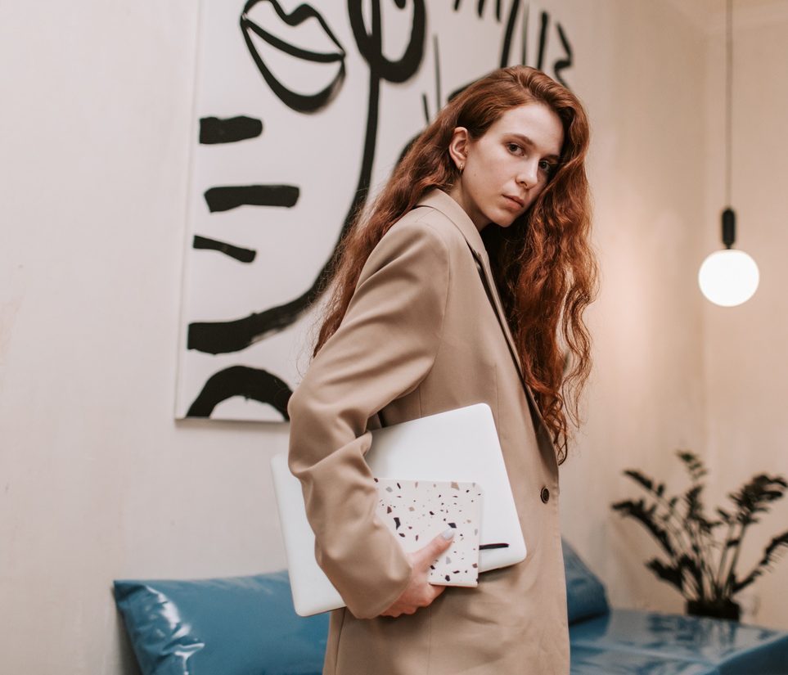
FASHIONRAG
Presented by Arvio Abe Suhendar
Page 01

Slide 2
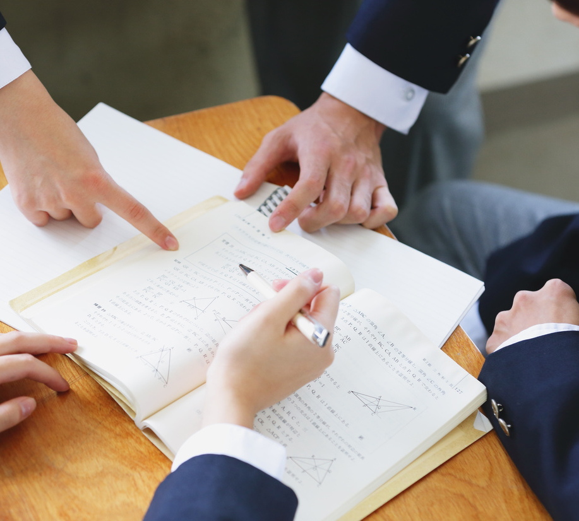
PROBLEM STATEMENT
Online fashion catalogs contain thousands of products
Users want accurate and contextual recommendations
Need for AI-powered semantic search
Page 02

Slide 3

OBJECTIVE
Design and implement a RAG system for fashion products
Improve search accuracy and recommendation quality in fashion catalogs
Combine text and image embeddings for better product understanding
Page 03

Slide 4

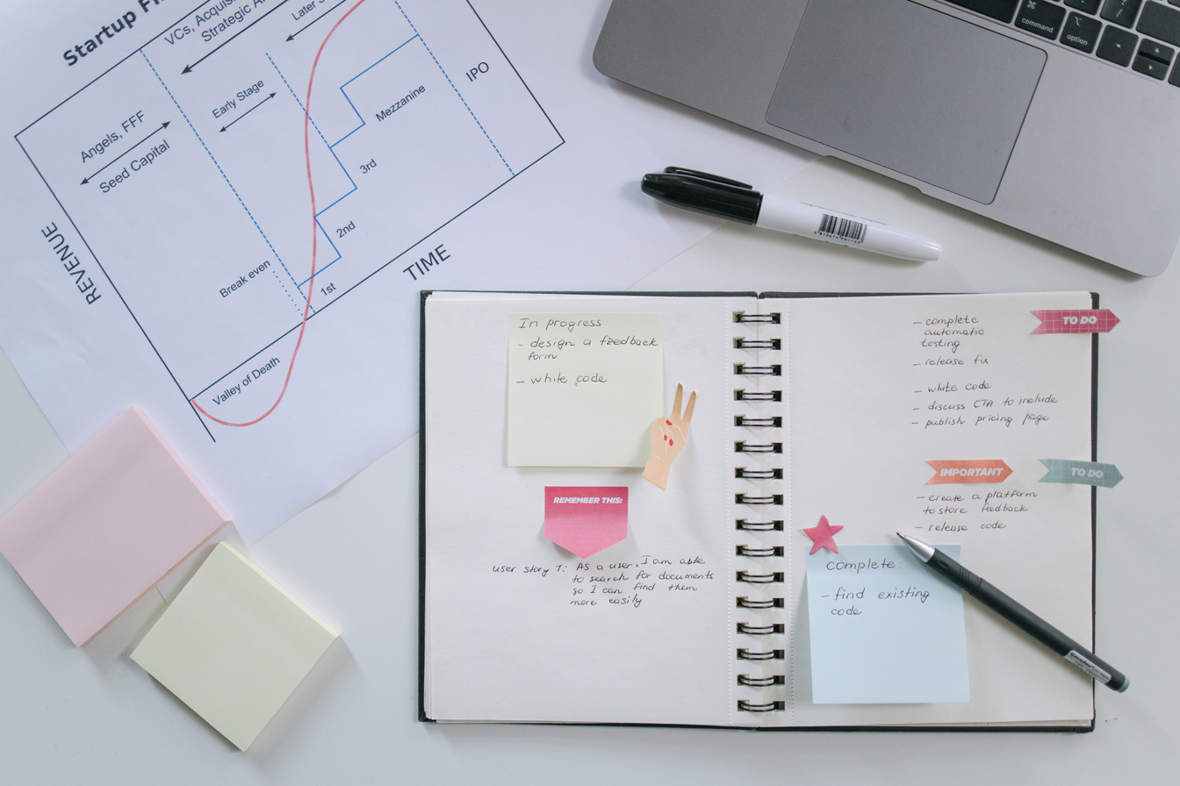


WORKFLOW
User query (text)
Text & image embedding
Similarity search with FAISS
Context retrieval (metadata + images)
LLM generates final response
Page 04
reallygreatsite.com

Slide 5
FEATURES
The dataset is saved in CSV format
Answering questions about Fashion products
Simple interface using Gradio
Multimodal output (text + image)
Page 06

Slide 6
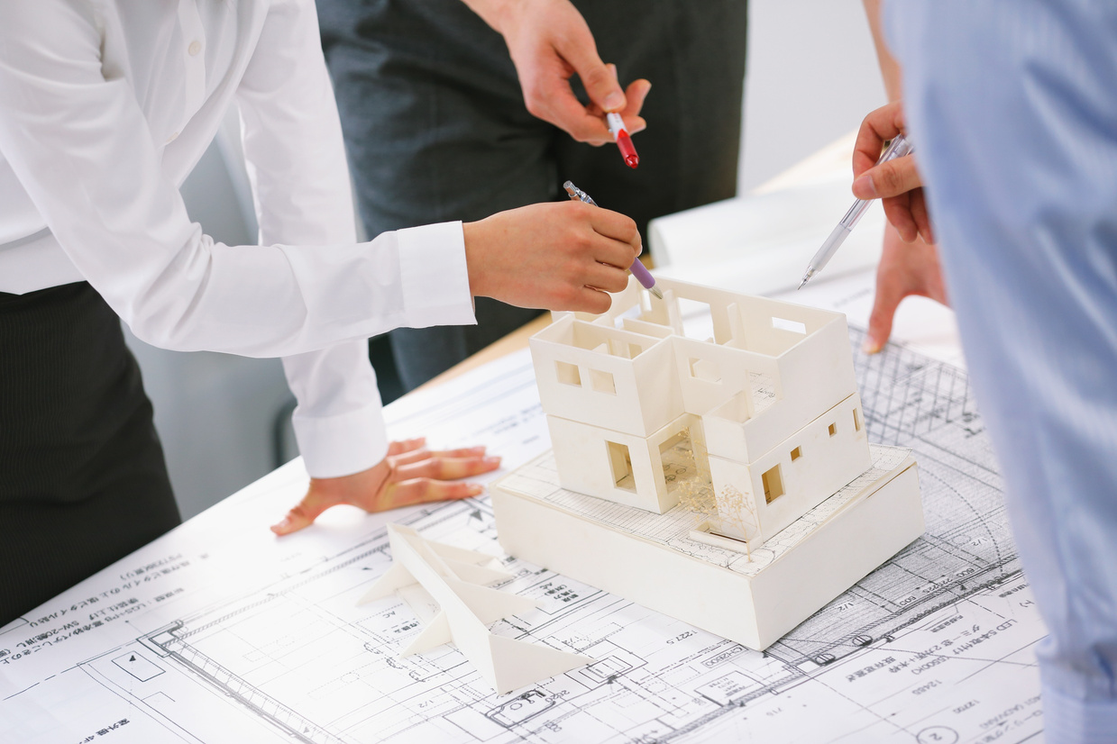

ARCHITECTURE
Load dataset
Cleaning Data
Create document
Embedding
Vector store
Retriever
LLM
Page 07

Slide 7
TOOLS & LIBRARY
Python | Langchain | Pandas | Numpy | Transformers | Json
OIlama | PIL | tqdm | faiss | Gradio | Torch
LLM Model : qwen2.5:0.5b
Embedding Model : laion/CLIP-ViT-B-32-laion2B-s34B-b79K
Page 06

Slide 8


DATASET
Dataset : data.csv
FEATURES :
image
description
display_name
category
Page 08

Slide 9

LLM RULES
Only recommend 3 related products
Don't make up stories about the product
Only recommend products that match the query
Use only the data provided
Briefly explain the related product
Page 09

Slide 10

EXAMPLE USE CASE
USER QUERY :
“I want to buy some shoes for men”
SYSTEM OUTPUT :
Retrieved relevant products
Displayed images
Generated recommendation text
Page 10

Slide 11
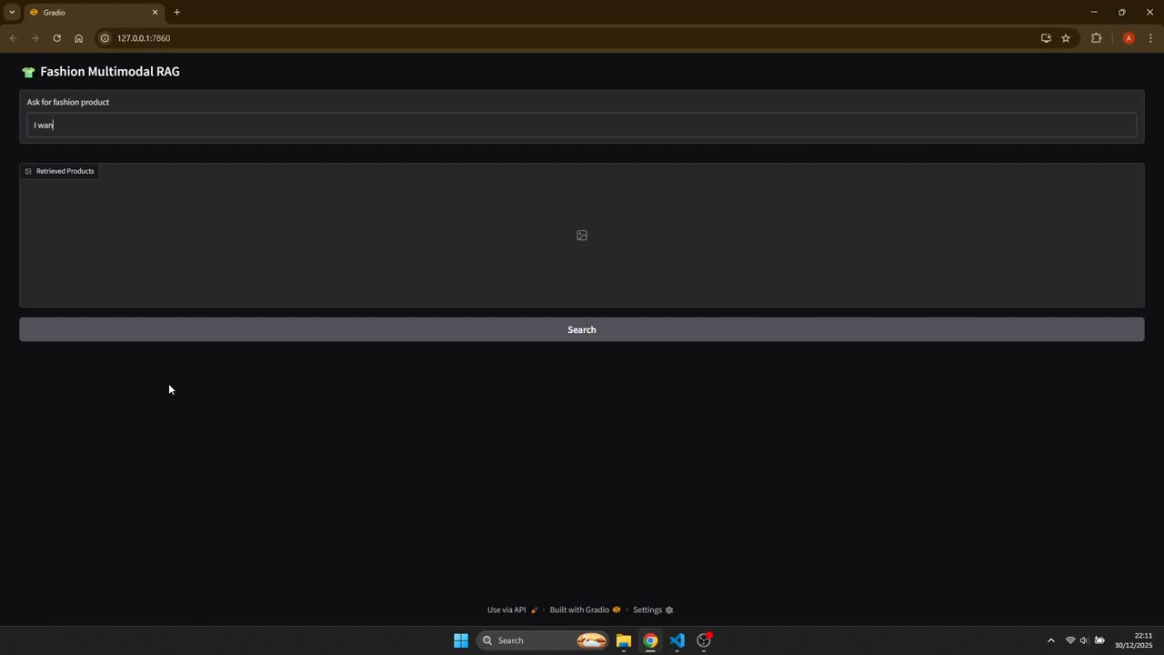
RESULTS
Page 11

Slide 12

CONTRIBUTION
Using larger and more complex datasets
Experimenting with different LLM models
Perfecting the design of the gradient to make it better
Page 12

Slide 13

CONCLUSION
Fashion RAG improves product search and recommendation
Multimodal RAG is effective for real-world applications
Can be extended to other domains
Page 13

Slide 14

THANKS
ABOUT ME
I am currently learning and building a career in AI/ML. This project is my practice to build a simple python application. I want to further develop my skills in this field through existing projects.
Page 14
Linkedin
Email
Github
Arvio Abe Suhendar
4rv10suhendar@gmail.com
arvio1378

